Slide 1
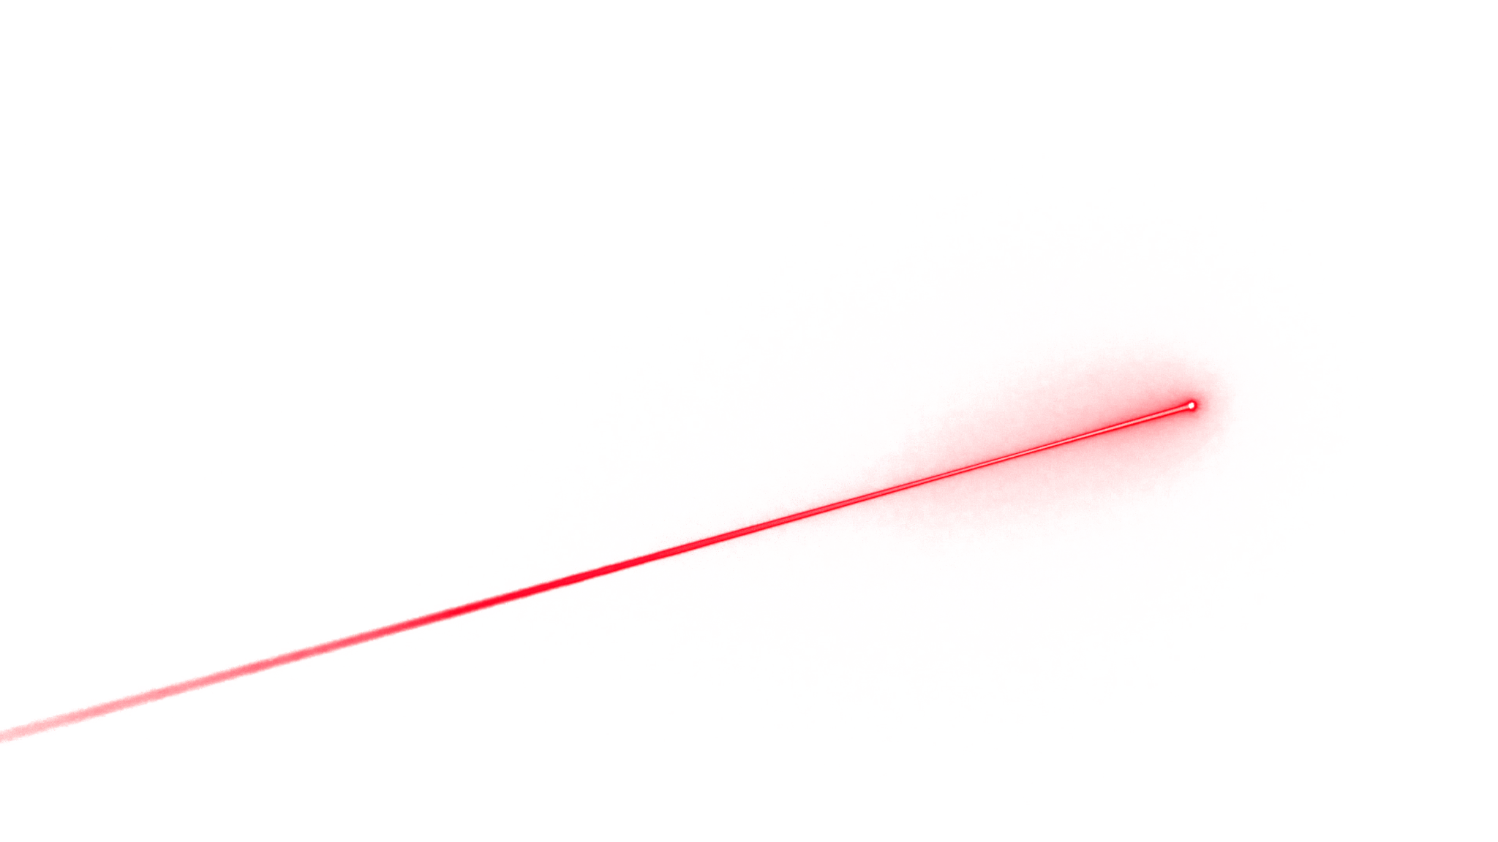
LIGHT THE BEAM
Isaiah Guilfoile, Thomas Hinkley, Croix Raney
Notes:
Sacramento king

Slide 2
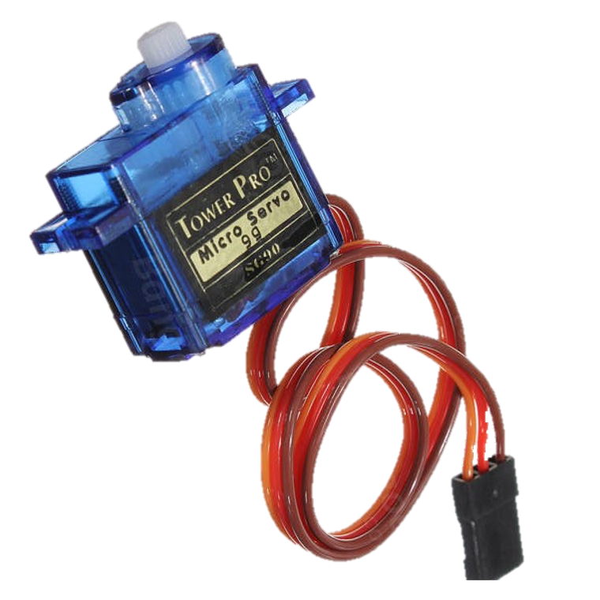
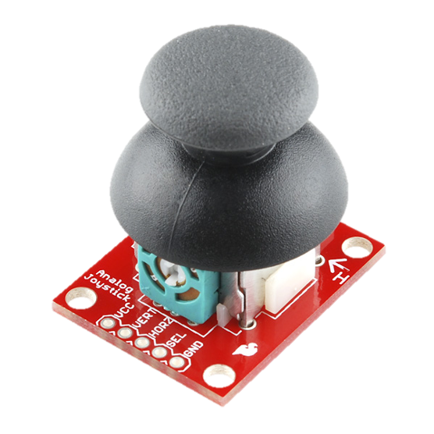
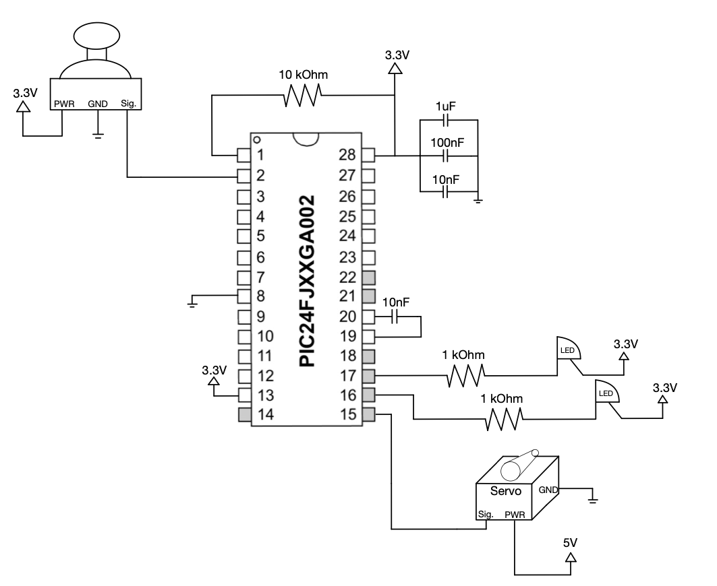
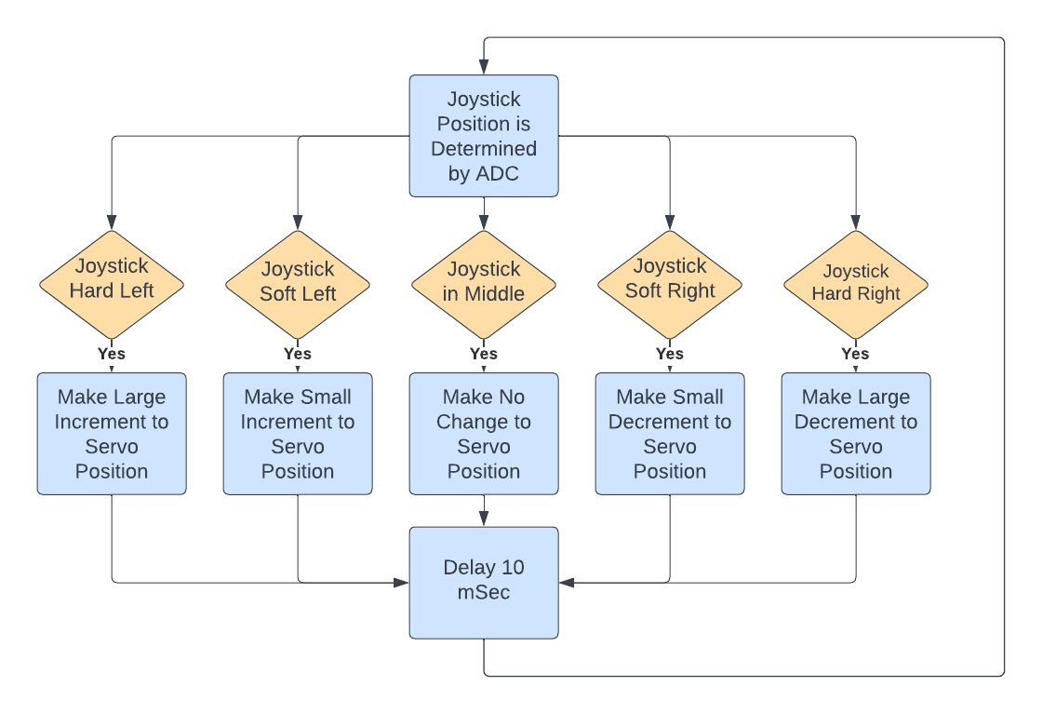
PIC24 Alpha Overview
Notes:
New Component: Joystick
Joystick operates via 2 10k-Ohm potentiometers in horizontal and vertical axis and simple button for press
Requires 3.3V supply and ground connection. Horizontal, Vertical, and Button each has their own pin
Since our project only uses one axis of motion, we only perform ADC on vertical pin output voltage
Servo Motor requires 5V power, supplied by micro-USB breakout. PWM Signal is provided by PIC24 as in Lab 4
ADC Buffer is updated about 40 times per second. Joystick position variable is updated with each ADC reading.
As shown in algorithm, servo position is updated based on current joystick reading.
Joystick is responsive and there is no noticeable input delay. Servo motion appears smooth

Slide 3
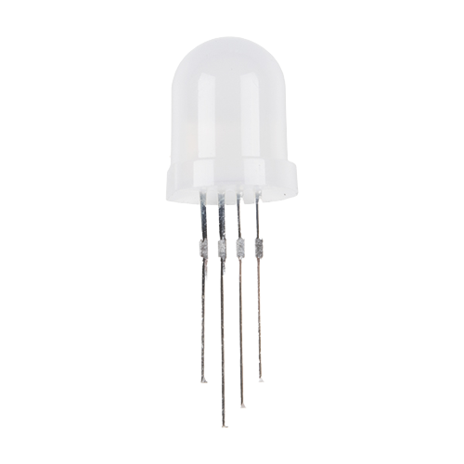
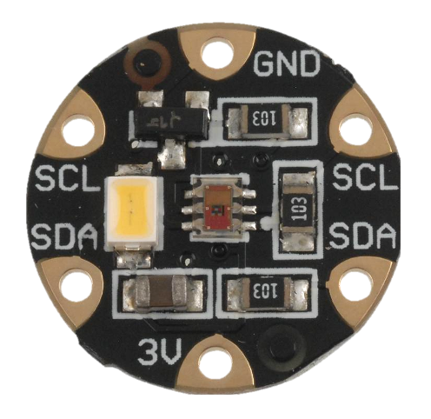
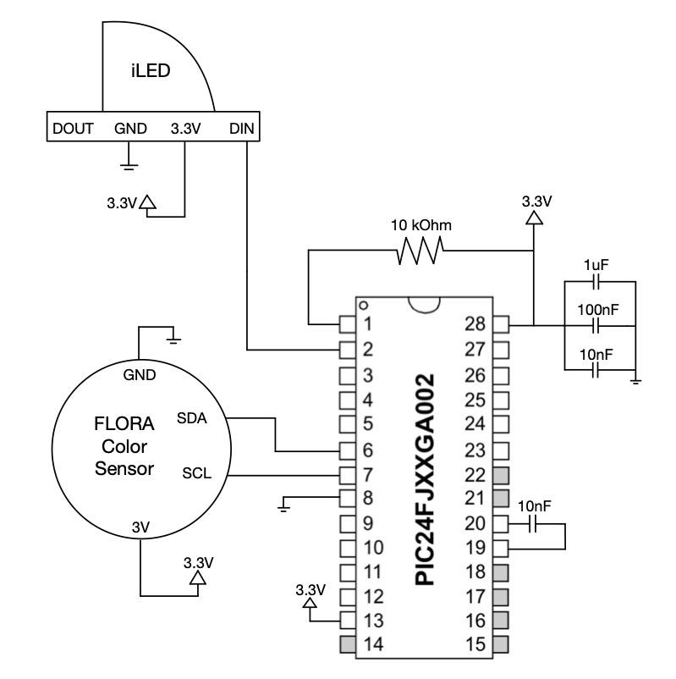
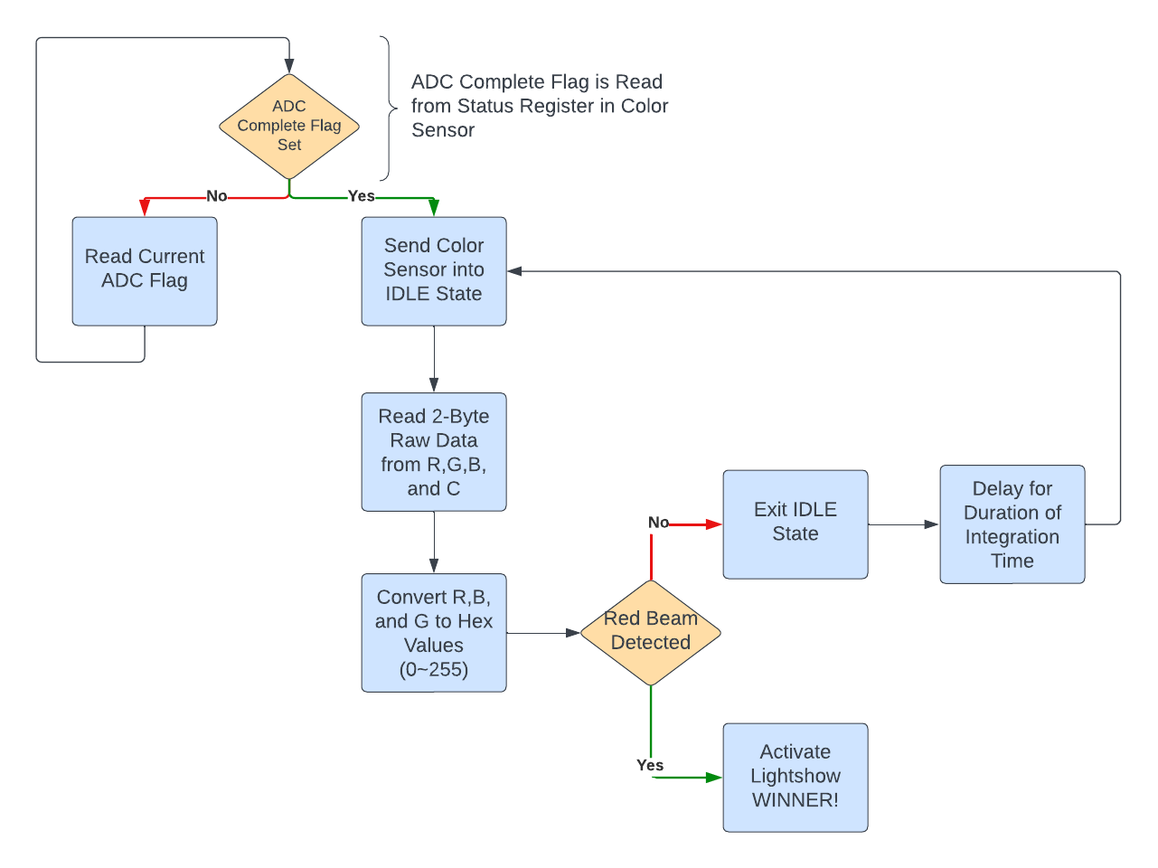
PIC24 Beta Overview
Notes:
New component: Color sensor
Color sensor operates using I2C and takes in raw color values and converts using an internal ADC and then is read using a 2-byte read instruction sent from the pic24
Color sensor requires a 3.3V, ground, SCL, SDA connections
From the state diagram, the color sensor reads the color given to the sensor at a given time and waits for the ADC to finish conversion, and then the pic24 reads the 2 bytes from the red registers and converts it hex, and then from there
If the value is the same as the expected value for the red beam, the light show is activated and the winner is crowned.
Reused component: iLED bulb:
The LED bulb runs through a for loop going from red to purple to blue and back again as a callback to the original project idea inspired by the sacramento kings
Similar to the labs done during the semester, the iLED is run using PWM signals created in assembly

Slide 4
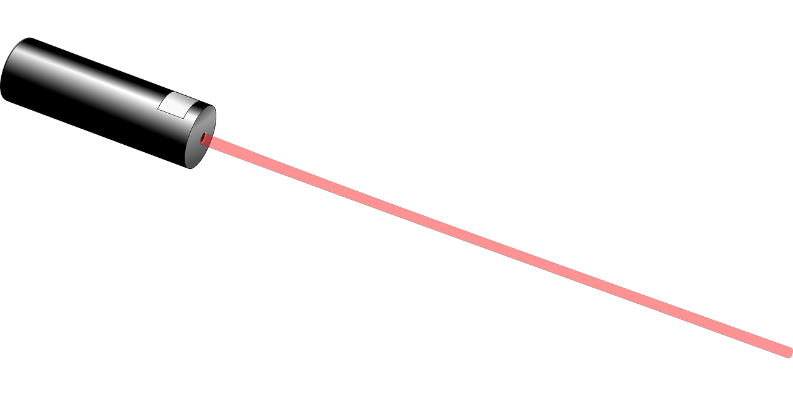
Team Member Contributions
Initial Research: Croix, Isaiah and Thomas
Flora Color Sensor: Croix, Isaiah and Thomas
Joystick/Servo: Isaiah and Thomas
iLED to Color Sensor: Croix
Debugging of all major coding sections: Croix and Isaiah
Hardware and Circuit Diagrams: Thomas
Algorithm Diagrams: Isaiah
Notes:
Wanted to keep each other informed and have an equal work distribution - everyone worked very collaboratively but also had individual side projects
-just talk about our workflow

Slide 5
Library Descriptions
Joystick Library:
ADC Conversion can be used to detect vertical and horizontal movement
This can be used to control physical motion in thousands of applications
What to call:
ADC_init()
{Slow/Fast}_{Left/Right} functions
Color Sensor Library:
I2C serial communication controlled device in which can be used to sense red, green and blue values for any item placed in front of the device.
What to call:
sensor_init()
getRGB()
i2c_read16bits()
exitIdle()
Notes:
Joystick:
ADC_init()
Sets up ADC pin, Conversion timing, and sample rate on timer3. ADC Interrupt Service Routine is enabled, where position variable is updated
Directional Movement Functions:
Allow for smooth, responsive servo position updates based on how far the Joystick is being used. This can be adapted to change the rate of change of anything controlled by the joystick.
Color Sensor:
sensorinit()
Uses multiple i2c write functions calls to turn on and initialize the Color sensor to a certain integration time
getRGB()
Takes in raw data from the I2c and converts it into clean RGB values which can be used to create colors
I2c read 16 sends a write bit along with the register address of a given color wanted, it does an incremented read which sets the control register to two byte read mode which will take the data from both the low register and high register of each color.
exitIdle()
Exits the idle state of the i2c by sending a single write command to re-enable the sensor to update the reading

Slide 6
Limitations and Future Possibilities
Limitations:
Unpredictable color sensor behavior
Laser Distortion
Requires two PIC24s for current operation
Future Possibilities
PIC24 controlled laser
Adding mirrors/spinning mirrors, blocking obstacles, other moving components
Adding graphic designs
3D range of motion
Winning music
Notes:
Lims:
Color Sensor - natural/ambient light distorts numbers
Laser Distortion - OG mirror idea - not one beam = unequal refraction
Future:
Obstacles to make game more hands on
Graphic to make game more fun and colorful

Slide 7
THANK YOU FOR LISTENING
Questions?

